Slide 1

CHAPTER 2 Operating System Overview
Instructor: Wuman LUO
luowuman@ipm.edu.mo
Office: A213
14:30-17:30 Tuesday & Wednesday

Slide 2

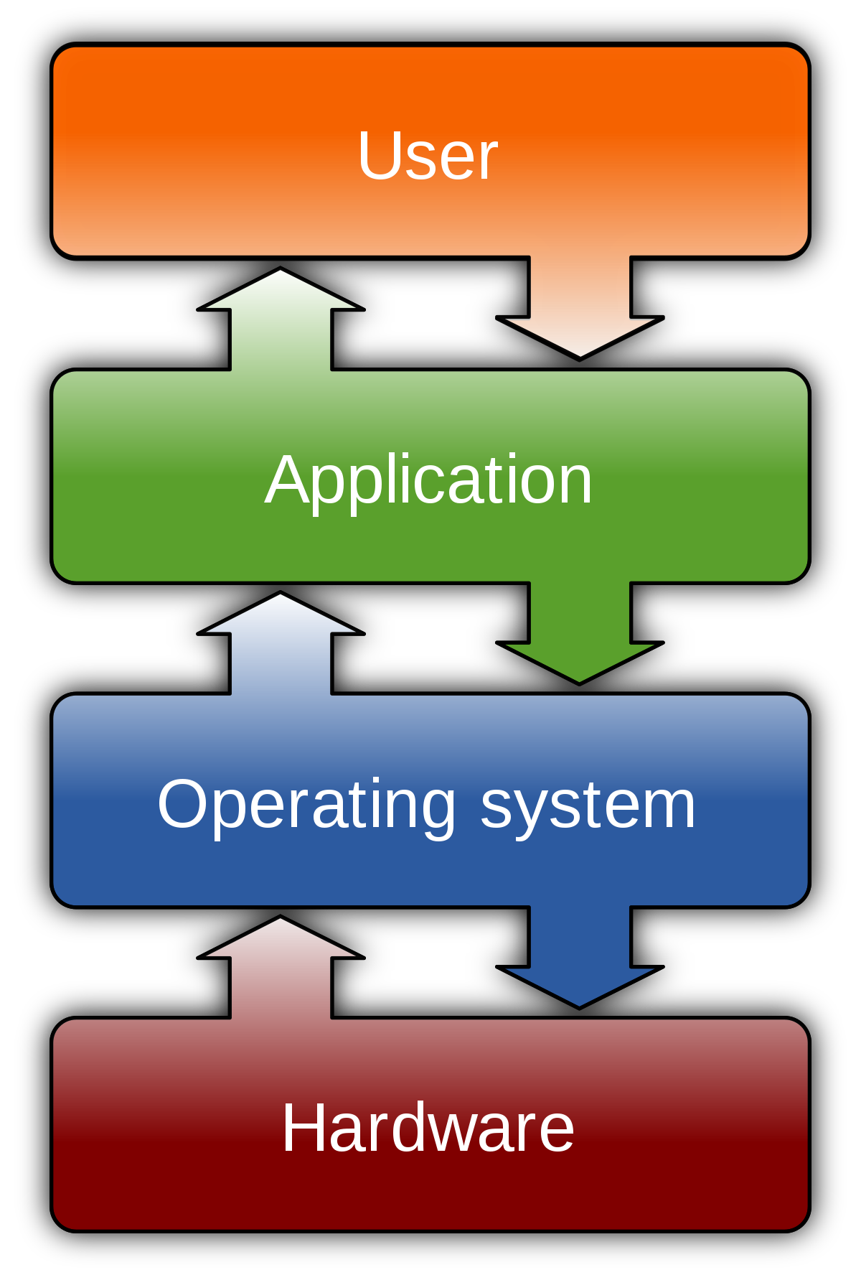
Operating System
A program that controls the execution of application programs
An interface between applications and hardware

Slide 3

Objectives
Convenience
Provide services to various users
Mask details of the hardware
Efficiency
Resources: CPU, memory, I/O devices
Ability to evolve
Should permit the effective development, testing, and introduction of new system functions without interfering with service.
Notes:
Convenience: An OS makes a computer more convenient to use.
Efficiency: An OS allows the computer system resources to be used in an efficient manner.
Ability to evolve: An OS should be constructed in such a way as to permit the effective development, testing, and introduction of new system functions without interfering with service.

Slide 4
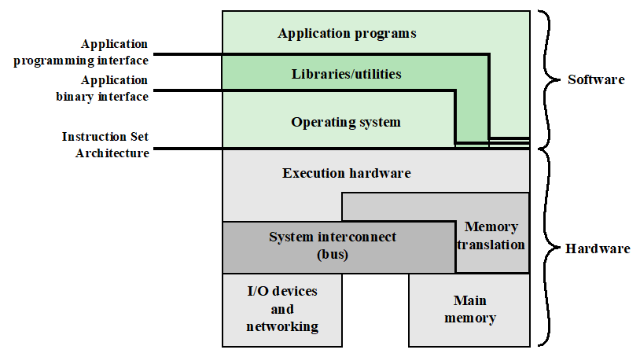
Computer Hardware and Software Infrastructure
Notes:
The hardware and software used in providing applications to a user can be viewed in a layered or hierarchical fashion. The user of those applications, the end user, generally is not concerned with the details of computer hardware. Thus, the end user views a computer system in terms of a set of applications. An application can be expressed in a programming language and is developed by an application programmer. If one were to develop an application program as a set of machine instructions that is completely responsible for controlling the computer hardware, one would be faced with an overwhelmingly complex undertaking.
To ease this chore, a set of system programs is provided. Some of these programs are referred to as utilities, or library programs. These implement frequently used functions that assist in program creation, the management of files, and the control of I/O devices. A programmer will make use of these facilities in developing an application, and the application, while it is running, will invoke the utilities to perform certain functions. The most important collection of system programs comprises the OS. The OS masks the details of the hardware from the programmer and provides the programmer with a convenient interface for using the system. It acts as mediator, making it easier for the programmer and for application programs to access and use those facilities and services.

Slide 5
Instruction Set Architecture (ISA)
Defines the set of machine language instructions that a computer can follow
Is the boundary between hardware and software
Both application programs and utilities may access the ISA directly
User ISA and system ISA
Notes:
For these programs, a subset of the instruction repertoire is available (user ISA). The OS has access to additional machine language instructions that deal with managing system resources (system ISA).

Slide 6
Application Binary Interface (ABI)
Defines a standard for binary portability across programs
Defines the system call interface to the operating system
Defines the hardware resources and services available in a system through the user ISA

Slide 7
Application Programming Interface (API)
Gives a program access to the hardware resources and services available in a system
through the user ISA supplemented with high-level language (HLL) library calls
Enables application software to be ported easily to other systems that support the same API

Slide 8
Services Provided by the OS (1/3)
Program development
Editors and debuggers
Not strictly part of the core of OS, but supplied with the OS
Program execution
OS handles scheduling of numerous tasks required to execute a program
E.g., data loading, I/O devices and files initialization, etc.
Access I/O devices
Each device will have unique interface
OS presents standard interface to users
Notes:
Program development:
The OS provides a variety of facilities and services, such as editors and debuggers, to assist the programmer in creating programs.
Typically, these services are in the form of utility programs that, while not strictly part of the core of the OS, are supplied with the OS and are referred to as application program development tools.
Program execution:
A number of steps need to be performed to execute a program.
Instructions and data must be loaded into main memory, I/O devices and files must be initialized, and other resources must be prepared.
The OS handles these scheduling duties for the user.
Access to I/O devices:
Each I/O device requires its own peculiar set of instructions or control signals for operation.
The OS provides a uniform interface that hides these details so that programmers can access such devices using simple reads and writes.

Slide 9
Services Provided by the OS (2/3)
Controlled access to files
Accessing different media but presenting a common interface to users
Provides protection mechanisms in multi-access systems
System access
Controls access to the system and its resources
Provide protection of resources and data from unauthorized users
Resolve conflicts for resource contention
Notes:
Controlled access to files:
For file access, the OS must reflect a detailed understanding of not only the nature of the I/O device (disk drive, tape drive) but also the structure of the data contained in the files on the storage medium.
In the case of a system with multiple users, the OS may provide protection mechanisms to control access to the files.
• System access:
For shared or public systems, the OS controls access to the system as a whole and to specific system resources.
The access function must provide protection of resources and data from unauthorized users and must resolve conflicts for resource contention.

Slide 10
Services Provided by the OS (3/3)
Error detection and response
Internal and external hardware errors
E.g., memory error, device failure, malfunction, etc.
Software errors
E.g., division by zero, accessing forbidden memory location, etc.
Should provide a response clearing the error condition
With least impact on running applications
Accounting
Collect usage statistics
Monitor performance
Notes:
Error detection and response:
A variety of errors can occur while a computer system is running.
These include internal and external hardware errors, such as a memory error, or a device failure or malfunction;
and various software errors, such as division by zero, attempt to access forbidden memory location, and inability of the OS to grant the request of an application.
In each case, the OS must provide a response that clears the error condition with the least impact on running applications.
The response may range from ending the program that caused the error, to retrying the operation, to simply reporting the error to the application.
Accounting:
A good OS will collect usage statistics for various resources and monitor performance parameters such as response time.
On any system, this information is useful in anticipating the need for future enhancements and in tuning the system to improve performance.
On a multiuser system, the information can be used for billing purposes.

Slide 11

The Role of an OS
A computer is a set of resources for the movement, storage, and processing of data
The OS is responsible for managing these resources
E.g., I/O, main and secondary memory, and processor execution time

Slide 12
Operating System as Software
The OS functions in the same way as an ordinary computer software
It is a program that is executed by the CPU
Operating system relinquishes (gives up) control of the processor
Must depend on the processor to allow it to regain control
Notes:
While executing, the OS decides how processor time is to be allocated and which computer resources are available for use. But in order for the processor to act on these decisions, it must cease executing the OS program and execute other programs. Thus, the OS relinquishes control for the processor to do some “useful” work, then resumes control long enough to prepare the processor to do the next piece of work. The mechanisms involved in all this should become clear as the chapter proceeds.

Slide 13
OS as Resource Manager
Notes:
Figure 2.2 suggests the main resources that are managed by the OS.
A portion of the OS is in main memory.
Kernel: contains the most frequently used functions
at a given time, other portions of the OS currently in use.
The remainder of main memory contains
user and utility programs and data.
The OS and the memory management hardware in the processor jointly control the allocation of main memory.
The OS decides when an I/O device can be used by a program in execution, and controls access to and use of files.
The processor itself is a resource, and the OS must determine how much processor time is to be devoted to the execution of a particular user program.

Slide 14
Evolution of Operating Systems
A major OS will evolve over time for a number of reasons:
hardware upgrades
new types of hardware
new services
fixes

Slide 15
Evolution of Operating Systems
Stages include:
Serial Processing
Simple Batch Systems
Multiprogrammed Batch Systems
Time Sharing Systems

Slide 16
Serial Processing
Earliest Computers
Problems
No operating system
Programmers interacted directly with the computer hardware
Computers ran from a console with display lights, toggle switches, some form of input device, and a printer
Users have access to the computer in “series”
Scheduling:
Most installations used a hardcopy sign-up sheet to reserve computer time
Time allocations could run short or long, resulting in wasted computer time
Setup time
A considerable amount of time was spent just on setting up the program to run
Notes:
With the earliest computers, from the late 1940s to the mid-1950s, the programmer interacted directly with the computer hardware; there was no OS. These computers were run from a console consisting of display lights, toggle switches, some form of
input device, and a printer. Programs in machine code were loaded via the input device (e.g., a card reader). If an error halted the program, the error condition was indicated by the lights. If the program proceeded to a normal completion, the output
appeared on the printer.
These early systems presented two main problems:
• Scheduling : Most installations used a hardcopy sign-up sheet to reserve computer time.
A user might sign up for an hour and finish in 45 minutes; this would result in wasted computer processing time. On the other hand, the user might run into problems, not finish in the allotted time, and be forced to stop before resolving the problem.
• Setup time: A single program, called a job , could involve loading the compiler
plus the high-level language program (source program) into memory, saving the compiled program (object program) and then loading and linking together the object program and common functions. Each of these steps could involve mounting or dismounting tapes or setting up card decks. If an error
occurred, the hapless user typically had to go back to the beginning of the setup sequence. Thus, a considerable amount of time was spent just in setting up the program to run.
This mode of operation could be termed serial processing , reflecting the fact that users have access to the computer in series. Over time, various system software tools were developed to attempt to make serial processing more efficient. These include libraries of common functions, linkers, loaders, debuggers, and I/O driver routines that were available as common software for all users.

Slide 17
Simple Batch Systems
Early computers were very expensive
Important to maximize processor utilization
Basic idea: Monitor
User no longer has direct access to processor
Job is submitted to computer operator who batches them together and places them on an input device
Program branches back to the monitor when finished
Notes:
Early computers were very expensive, and therefore it was important to maximize processor utilization. The wasted time due to scheduling and setup time was unacceptable.
To improve utilization, the concept of a batch OS was developed. It appears that the first batch OS (and the first OS of any kind) was developed in the mid-1950s by General Motors for use on an IBM 701 [WEIZ81].
The central idea behind the simple batch-processing scheme is the use of a piece of software known as the monitor . With this type of OS, the user no longer has direct access to the processor. Instead, the user submits the job on cards or tape to a computer operator, who batches the jobs together sequentially and places the entire batch on an input device, for use by the monitor. Each program is constructed to branch back to the monitor when it completes processing, at which point the monitor automatically begins loading the next program.

Slide 18
Modes of Operation
User Mode
User program executes in user mode
Certain areas of memory protected from user access
Certain instructions may not be executed
Kernel Mode
Privileged instructions (e.g. I/O instructions) may be executed, all memory accessible.
Can be executed only by the monitor
Notes:
Considerations of memory protection and privileged instructions lead to the concept of modes of operation.
A user program executes in a user mode, in which certain areas of memory are protected from the user’s use and in which certain instructions may not be executed.
The monitor executes in a system mode, or what has come to be called kernel mode, in which privileged instructions may be executed and in which protected areas of memory may be accessed.

Slide 19
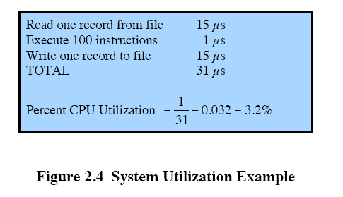
Multiprogrammed Batch Systems
CPU is often idle
Even with automatic job sequencing.
I/O devices are slow compared to processor
Notes:
Even with the automatic job sequencing provided by a simple batch operating system, the processor is often idle.
The problem is that I/O devices are slow compared to the processor.
Figure 2.4 details a representative calculation.
The calculation concerns a program that processes a file of records and performs, on average, 100 machine instructions per record.
In this example the computer spends over 96% of its time waiting for I/O devices to finish transferring data to and from the file.

Slide 20
Uniprogramming
Processor must wait for I/O instruction to complete before preceding
Notes:
In a single application system, uniprogramming, the processor spends a certain amount of time executing, until it reaches an I/O instruction.
It must then wait until that I/O instruction concludes before proceeding.
This inefficiency is not necessary.

Slide 21
Multiprogramming (Multitasking) (1/2)
Running more than one programs at the same time
When one job needs to wait for I/O, the processor can switch to the other job

Slide 22
Multiprogramming (Multitasking) (2/2)
Multiprogramming
Memory is expanded to hold three, four, or more programs and switch among all of them
Central theme of modern operating systems

Slide 23
Time-sharing Systems
Using multiprogramming to handle multiple interactive jobs
Processor’s time is shared among multiple users
Multiple users simultaneously access the system through terminals
OS interleaving the execution of each user program in a short burst or quantum of computation
Notes:
With the use of multiprogramming, batch processing can be quite efficient. However, for many jobs, it is desirable to provide a mode in which the user interacts directly with the computer. Indeed, for some jobs, such as transaction processing, an interactive mode is essential.

Slide 24
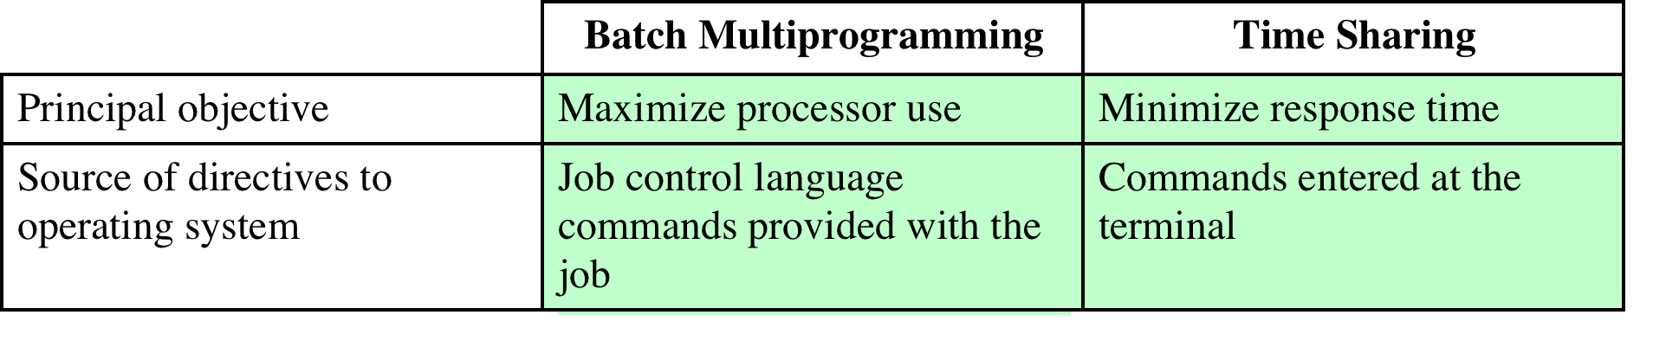
Batch Multiprogramming vs. Time Sharing

Slide 25

Topics we shall study…
Process management (chap 3,4,5,6)
Memory management (chap 7,8)
Input/Output (chap 11)
File systems (chap 12)

Slide 26

Next Topic
Process Description and Control
Read Ch. 3

